Slide 1

Finance Information Systems : Final Project
Group 9
Aditya Bhide
Amal Byju
Kathan Shah
Sreyas Sourav
Vaibhav Balasubramanian

Slide 2
"We pledge on our honor that we have not given nor received any unauthorized assistance on this assignment to/from other groups." - Aditya Bhide, Amal Byju, Kathan Shah, Sreyas Sourav, Vaibhav Balasubramanian

Slide 3
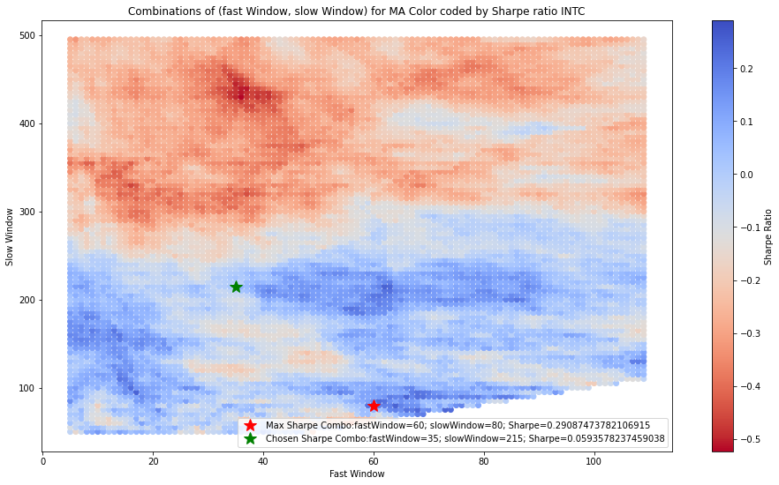
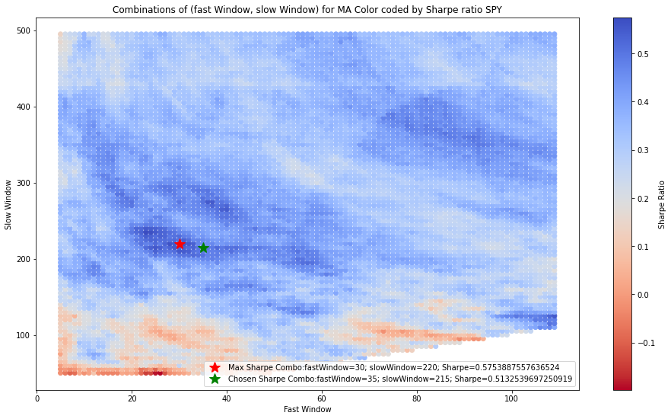
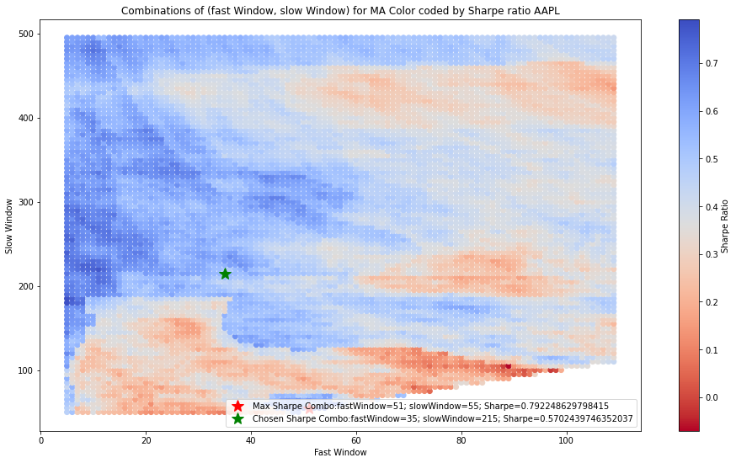
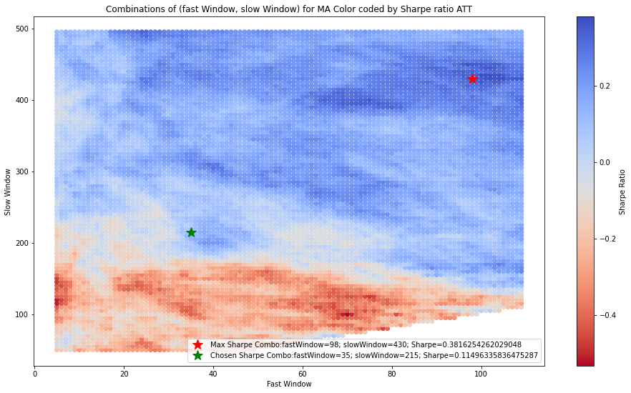
Strategy Selection
Moving Average Crossover ( Flat ) - AAPL, AMZN, EUR, GOLD, SPY
Moving Average Crossover ( Short ) - GE
Optimal fastWindow - 39 days
Optimal slowWindow - 210 days

Slide 4
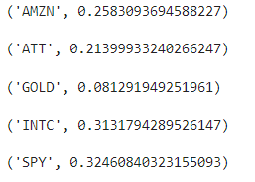
Bollinger Band Strategy
We ran Bollinger Band strategy for all securities and calculated the Sharpe ratios. We found that some of them were negative. So we filtered for the ones that were positive.
A few notable ones are AMZN, ATT, INTC and SPY. Of these, ATT and INTC perform better in this strategy as compared to the Moving Average strategy.
So we looked at the charts of their close prices.

Slide 5
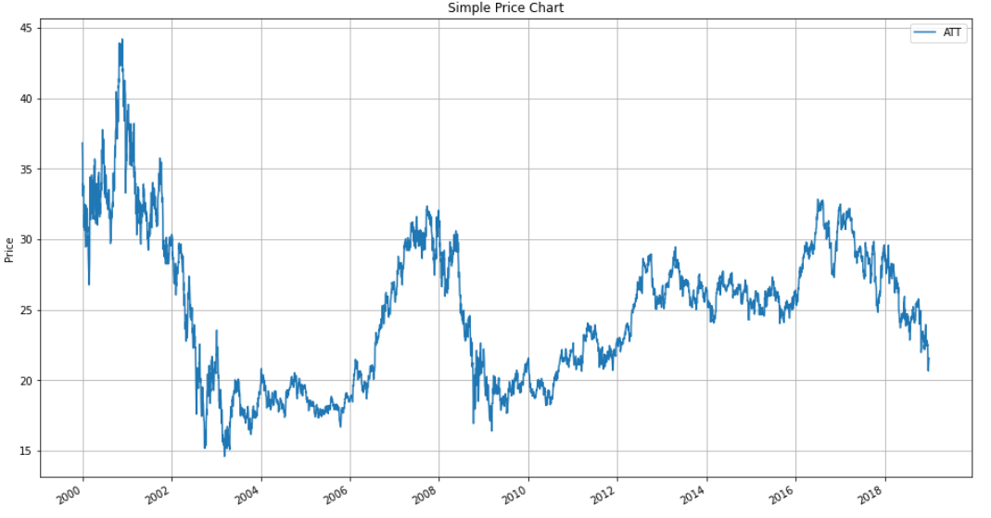
ATT seems like a good candidate for Bollinger Band strategy. There is no strong trend here.

Slide 6
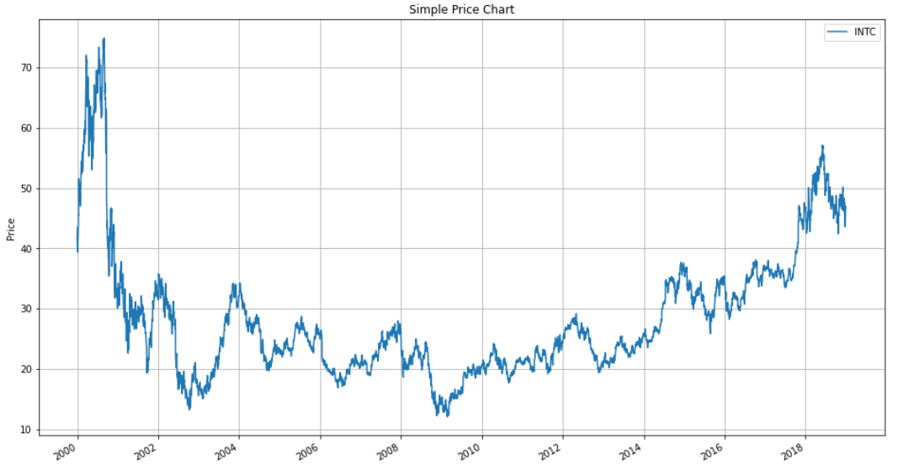
For INTC, there is an upward trend since 2010. Looking into the future, a trending strategy would be better.

Slide 7
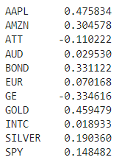
No Strategy
Here are the Sharpe ratios of securities without applying any strategy.
The Sharpe ratio of BOND is better here than any other strategy.

Slide 8
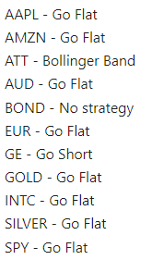
Chosen Strategies
We chose the following strategies after comparing the chosen Sharpe ratios in the previous analyses.
Since the majority of instruments use the Go Flat strategy, we used the window sizes of this strategy (39, 210).

Slide 9
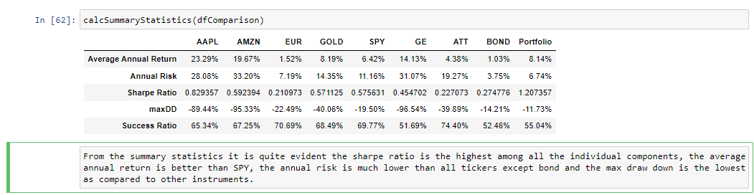
Final 8 securities
We have decided to remove SILVER since it is highly correlated with GOLD and has a lower Sharpe.
We have decided to remove AUD since it has lower Sharpe and higher risk than EUR.
We have decided to remove INTC since it is highly correlated with SPY and has lower Sharpe than SPY.
The final 8 securities are
AAPL, AMZN, EUR, GOLD, SPY, GE, ATT and BOND.

Slide 10
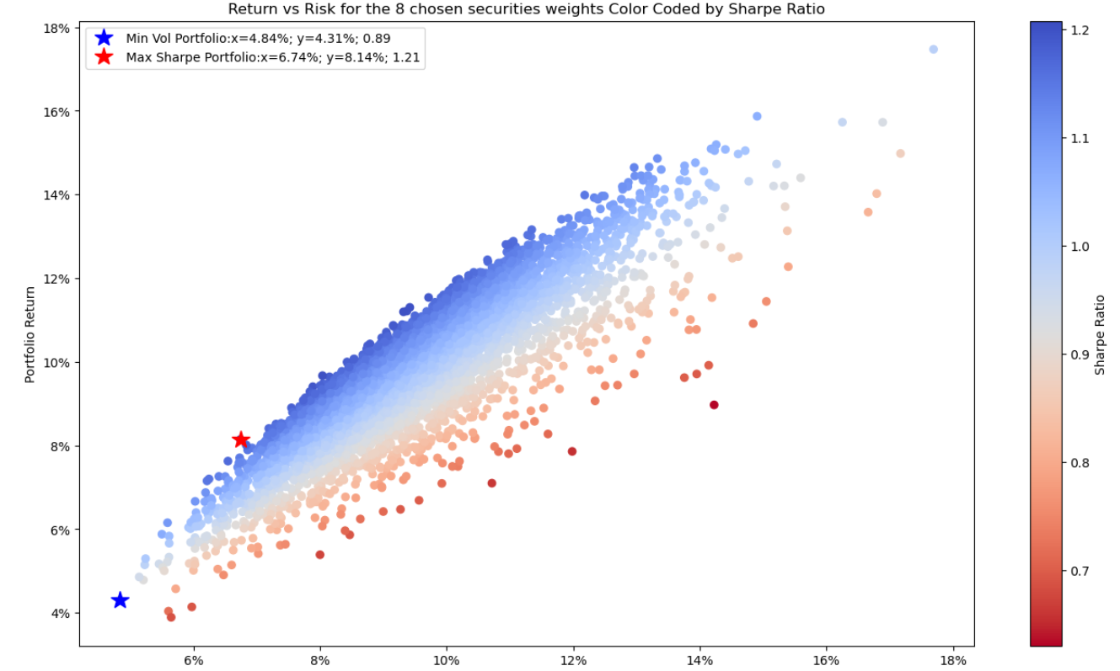
Mean-Variance Optimization
Weighing risk vs returns to make investment decisions
Construct minimum volatility and maximum Sharpe portfolios

Slide 11
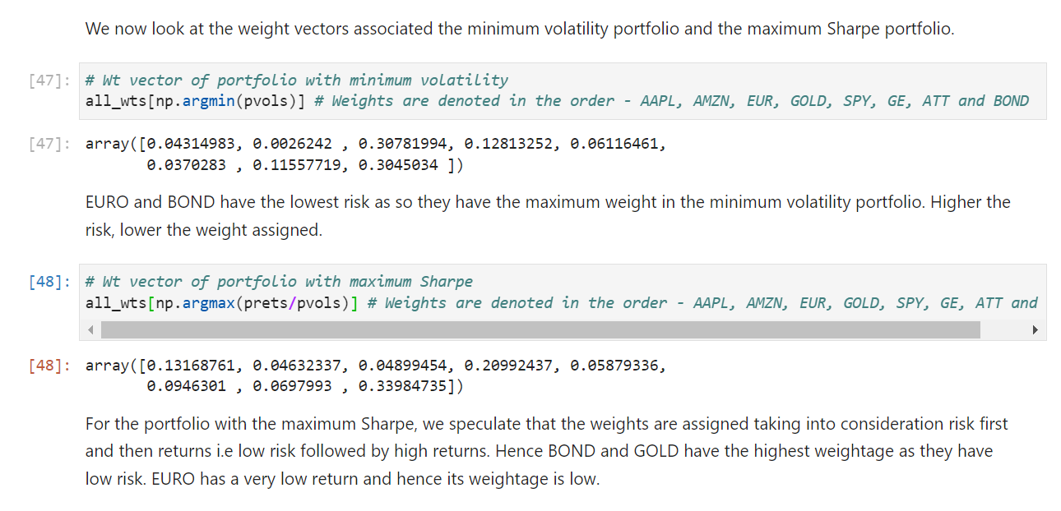

Slide 12
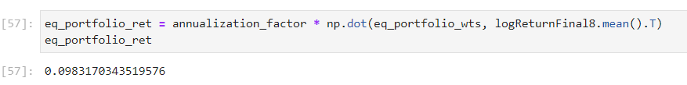

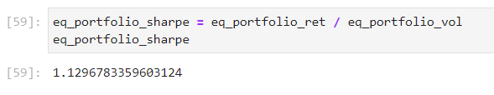
Equal Weighted Portfolio
Return
Volatility
Sharpe Ratio

Slide 13
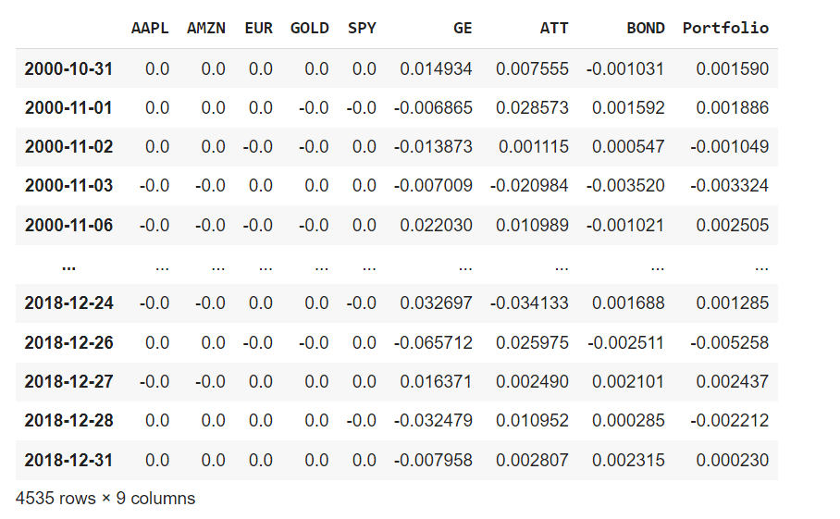
Maximum Sharpe Portfolio
Notes:
We multiply the maximum sharpe weights with the returns of the respective securities to get the Maximum Sharpe Portfolio
We then calculated the Beta value for our Maximum Sharpe Portfolio by running a OLS Regression model

Slide 14
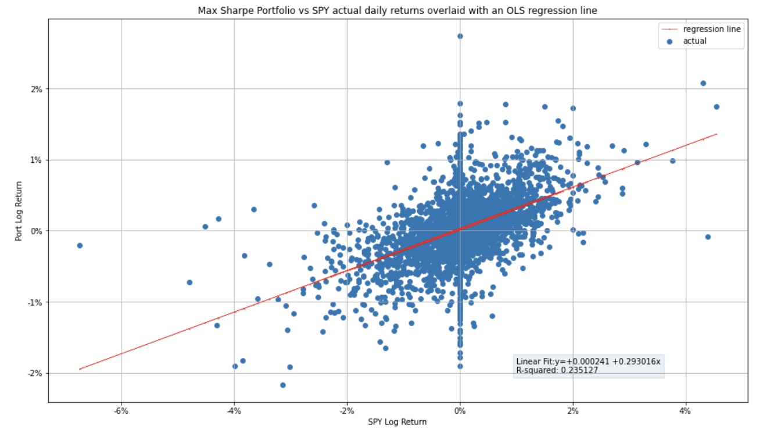
Beta for Maximum Sharpe Portfolio

Slide 15
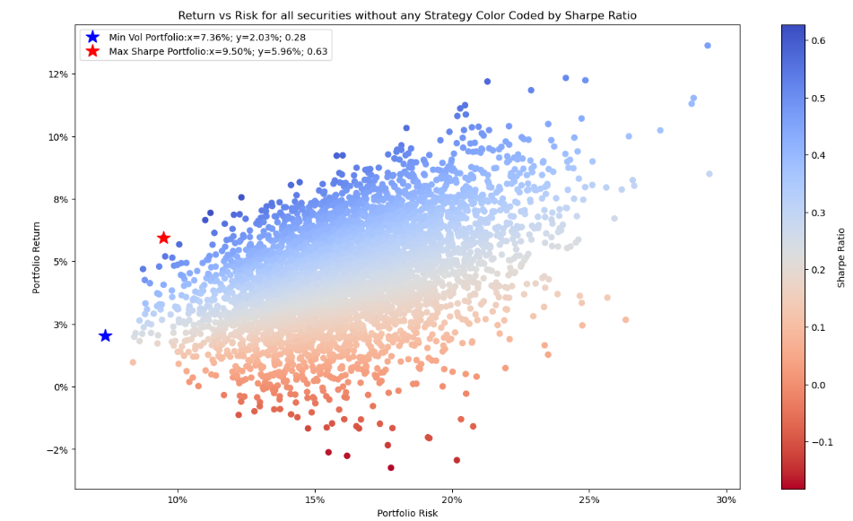
Mean-Variance Optimization for Passive Strategies
We decided to run the MVO using 5000 step Monte Carlo simulation for the passive strategies for our selected instruments in the portfolio which were - AAPL, AMZN, EUR, GOLD, SPY, GE, ATT, BOND
First ran the MVO without any strategies i.e, just the 8 instruments and the sharpe ratio was 0.63.
Then we ran the MVO for Go Flat Strategies for 7 instruments and Go Short Strategy for GE and the sharpe ratio was 1.18 using existing windows for the portfolio i.e. fast window = 39 and slow window = 210.
Finally, we ran the MVO for BB Strategy for the 8 instruments and the sharpe ratio was 0.33.
Thus from this we can conclude that the portfolio strategy selected was better than the strategy running by itself since the portfolio had a sharpe ratio of 1.21.

Slide 16
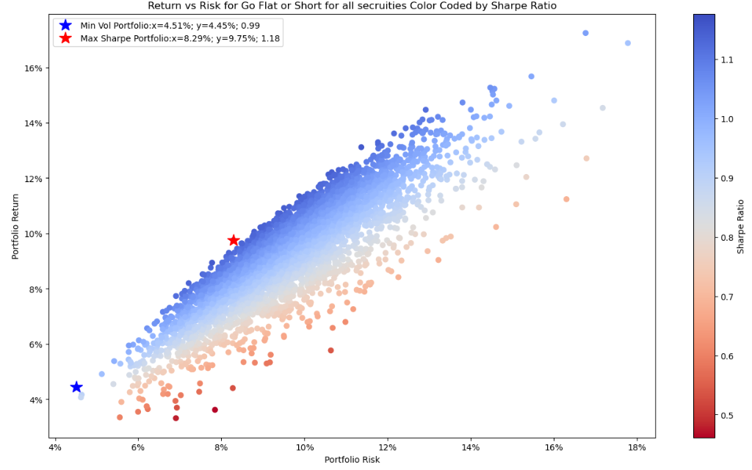
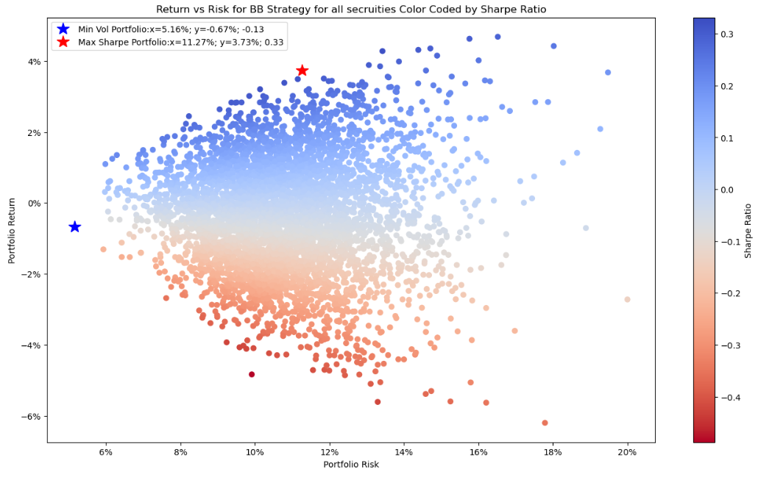
Mean-Variance Optimization for Passive Strategies

Slide 17
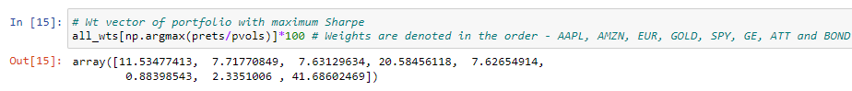
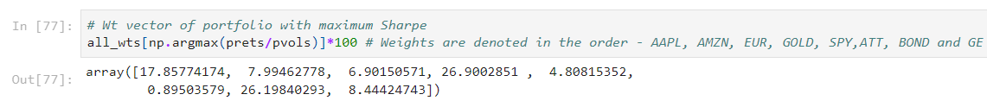
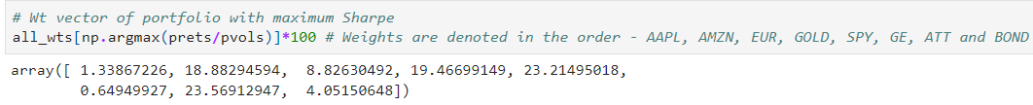
Optimal Weights for Passive Strategies
Optimal weights for the selected instruments using No Strategy
Optimal weights for the selected instruments using MA strategy
Optimal weights for the selected instruments using BB strategy

Slide 18
Conclusion
We were able to construct a super-optimized portfolio by using various strategies for different instruments.
To develop our strategy we tested every instrument using no strategy, MA (using various combinations of windows) and BB and based on the higher sharpe value we selected the strategies for 11 instruments.
To eliminate 3 instruments we created a correlation matrix and removed high correlation for some of the instruments and ran MVO which gave the highest sharpe.
The constructed portfolio performed better than running only single strategy or no strategy or having only equal weights which is quite evident and was observed from the sharpe ratio.

Slide 19
Thank You!

